Slide 1
BIOMETRIC SYSTEM BASED ELECTRONIC VOTING MACHINE USING RASPBERRY PI
Guide: Manu A P
Professor
PES Institute of Technology and Management
Shivamogga.
Presented by:
Mythri N Chittaragi (4PM17CS050)
Harshitha M (4PM17CS033)
Shwetha N (4PM17CS105)
Archana P (4PM17CS013)

Slide 2
ABSTRACT
The basis of this project is to create an Electronic Voting Machine that will help to eradicate defrauding of the manual voting Systems by multiple votes cast by the same user. Each voter will be entered into the system through a swift process only after being recognized and checked to the given database of enlisted voters. Once the corresponding fingerprint is matched with the information provided by the Identification Card, the voter will be allowed to vote for their preferred candidate through a panel of buttons. The proposed project also carries the unique feature of being autonomous during the course of operation, which helps to diminish the issue of hacking occurring in previous attempts of Electronic Voting Machines. This machine can be used as a Presenty muster in Government Office and GRs will be displayed on it.

Slide 3
INTRODUCTION
Voting is a method of electorate to decide or express an opinion. In a democratic country a ministry is choice through a vote in an election, among various candidates present for rule. In this voting scheme electorate are going to appoint their representatives in their government. The direct democracy is the processes were people are directly going to decide. Voting is a method of expressing an opinion or making of concerted judgment. In democratic community, the authority is named by the process of balloting. When we consider the ancient period people would poll their vote with the use of paper, punch card. It subsequently emerged from the general voting system to electronic voting machines (EVM). In general voting process had a vast issue about efficiency, resilience, isolation, authentication and insecurity. Here electronic voting system overthrown all these problems. Presently India is using the electronic voting system.

Slide 4
contd..
The project deals with the design and development of a web-based voting system using fingerprint authentication. The proposed EVS compels the voters to scan their fingerprint, which in turn is matched with preloaded image within the database. Being nationally connected, an user can cast votes from anywhere in the country through the web only after successful progress through the validation procedures. Casted vote will be updated immediately.
In this version of EVM, user at the polling booth needs to place his finger on the device.This Fingerprint reader reads the details from the tag which is then passed onto the controlling unit for the verification. The controller compares this data with the already existing data stored during the registration of the voters. If the data matches with the pre stored information of the registered fingerprint, the person is allowed to cast his vote. If not, a warning message is displayed on LCD and the person is barred from polling his vote.

Slide 5
HARDWARE REQUIREMENT
Raspberry PI (3B+ and 3A+)
Buzzer
Camera
Finger print Sensor
DC Motor

Slide 6
SOFTWARE REQUIREMENT
Raspberry PI OS
Python 2.7 onwards
Flask
HTML
CSS
JS
MySQL
Notes:
ggggg

Slide 7
LITERATURE SURVEY
The implementation of Biometric Electronic Voting System Software (BEVSS) integrated with a biometric fingerprint machine that allows eligible voters during the registration process with subsequent verification on Election Day has been projected. The BEVSS would be implemented on personal computers over a Local Area Network at each polling station.
This paper focuses on sophisticated voting system using RFID and Finger print technologies to ensure unique casting. RFID acts as a substitute for voter ID and the Fingerprint sensor data generates an alert depicting mismatches. Keypad is used for selecting the voting preferences. LCD is used to display the corresponding data for each key to the user.

Slide 8
contd..
It is basically an extension of the previous where aspects like authenticated voters and polling data security for e-voting systems are discussed. The voter authentication in online e-voting process can be done by formal registration through administrators and by entering one time password. In Offline e-voting process authentication can be done using Iris reorganization, finger vein sensing which enables the electronic ballot reset for allowing voters to cast their votes. Also the voted data details with voter details could be sent to the nearby Database Administration unit in a timely manner using GSM System with cryptography technique.

Slide 9
contd..
Another form of biometric EVM where the Gov. database has retrieved biometric data of fingerprint and IRIS. One more advantage of this project is, if an alcoholic person enters into polling booth, buzzer will alert authorized persons or constables who are on election duty. Because of Alcoholic sensor, we can provide peaceful environment at polling booth. If an unauthorized person or anyone who has already casted his vote enters into the polling booth with his RFID tag, buzzer will alert booth level officer.
In this proposal all the users should login by Aadhaar card number and password and click on his/her favorable candidates to cast the vote. The extra feature of the model is that the voter will ensure if his/her vote has gone to correct candidate/party

Slide 10
PROBLEM STATEMENT
Presently in India we are following the traditional way of authentication method by producing photo identity card issued by government authority, but the authority of allowing the voter to cast vote is in the hands of polling booth officer there he may allow fake voters to cast the vote. If the person is out of station he/she may lose his right of voting due to this recede the accuracy and rate of voting booth from elector vicinity and if elector is out of city he may lose his right to cast the vote which becomes the major drawback of the scheme, since the percentage of the electing voting booth of Indian election the moderate balloting is 70-80% where the individual will not be able to suffrage from any place.

Slide 11
OBJECTIVES
The E-voting casting system is best suitable for India because of its big geographic locality voting population literacy stage and illegal.
The biometric vote casting device is a versatile solution for mal practices within the loose and honest electoral process.
The documentary proofs like voters identity cards are maximum encounter duplication and alteration of the voter’s identity card.
The biometric vote casting machine ensures the unfastened and fair electoral manner. It can be termed because the technological solution for uphold democratic value.

Slide 12
METHODOLOGY
Initially an web application has been designed for voting system and published in Raspberry pi. Once lunched voter details will be entered into the application and respective electronic enabled card that is RFID Card will be given to each voter. Once successful registration on the day of election each voter have to bring electronic enabled card with them. While entering into the poll booth voter have to swipe the card it enables and check whether user is valid user or not and display voter information to the authority.
Once voter is verified, camera will be activated to check whether other person are present near voting ballot or not. If other persons are present then alert the authority regarding other person presence except a valid voter . authority will check the reason of presence and allow other person presence with valid reason.

Slide 13
contd..
Once voter is provided with sufficient privacy allowed to cast their vote by selecting the respective candidate and by providing the finger print. If the fingerprint is valid then it allow voter to vote and it will calculated to that candidate. If fingerprint is not valid then alert the authority and also image of that person is captured and further enquiry will be carried out.
The proposed work uses android mobile OS to develop an application and fingerprint supported biometric control information to make voting process more secure. Using android smart mobile device makes the system more robust.

Slide 14
contd..
This project proposes a secure online e-voting system that uses UIDAI or Aadhaar database as its backend. The system ensures authentication of an individual by matching fingerprints and eligibility is checked by calculating the age of the voter thus making the existing voting cards redundant.
A simple and secured method of polling vote by using biometrics –the proposal avoids false voting relying on fingerprint verification. The algorithm uses a cancelling approach, where each authorized person in the Government’s database is striked off in a polling area on successful polling –an attempt towards irradiating multicasting.

Slide 15
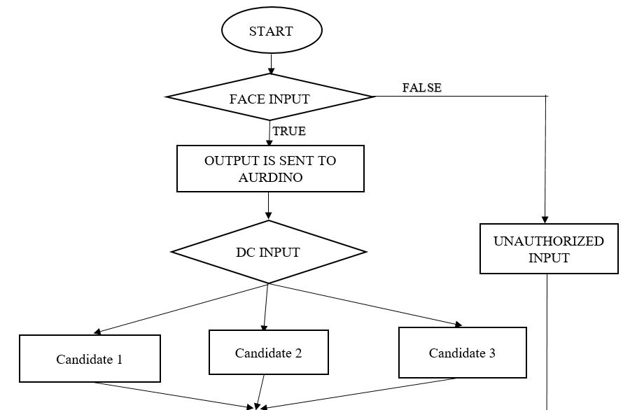
FLOW CHART OF BIOMETRIC VOTING SYSTEM

Slide 16
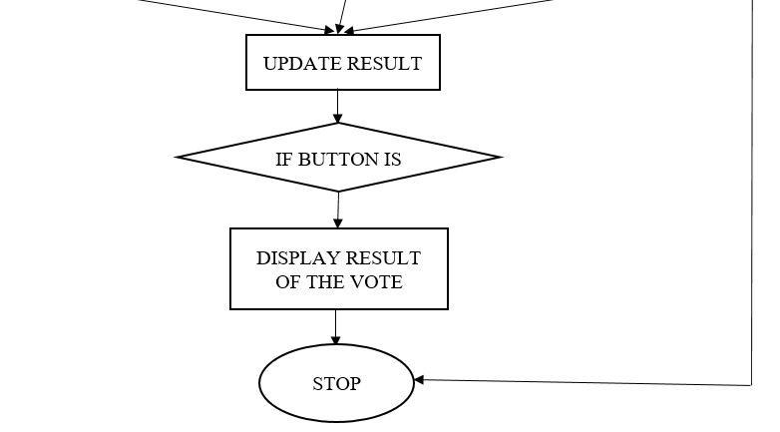
contd..

Slide 17
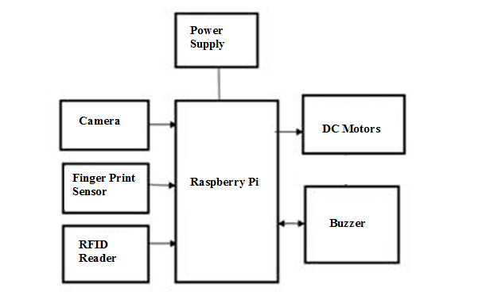
MODEL OF BIOMETRIC VOTING SYSTEM

Slide 18
EXPECTED OUTPUT
This proposed work is related to biometric system considering a right to vote from anywhere system which enables the elector to compute their vote from any place in India by using this biometric system based electronic voting machine using raspberry pi which provides the secure way of voting where a person cannot vote more than once where we consider fingerprint recognition system for the security purpose DE fraudulence is avoided by using this system and high accuracy, time is saved and fair voting process is been carried out.

Slide 19
REFERENCES
[1] Rahil Rezwan, Huzaifia Ahmed, M.R.N. Biplob, S.M. Shuvo, Md Abdur Rahman “BIOMETRICALLY SECURED ELECTRONIC VOTING MACHINE”, 2017 IEE Region 10 Humanitarian Technology Conference (R10-HTC).
[2] Shashank S Kadam, Ria N Choudhary, SujayDandekar, DebjeetBardhan, Prof.Namdeo B Vaidya “ELECTRONIC VOTING MACHINE WITH ENHANCED SECURITY”, 2018 IEEE Xplore Part Number: CFP18AWO-ART: ISBN: 978-1-5386-4765-3(ICCES 2018).
[3] Anandaraj S, Anish R, Deva Kumar P.V “SECURED ELECTRONIC VOTING MACHINE USING BIOMETRIC”, 2015 IEEE Sponsored second International Conference on Innovtions in Information, Embedded and Communication Systems(ICIIECS) 2015.
[4] J. Deepika, S.Kalaiselvi, S.Mahalakshmi “SMART ELECTRONIC VOTING SYSTEM BASED ON BIOMETRIC IDENTIFICATION SURVEY”, 2017 Third International conference on Science.

